Slide 1





APSC TEAM
NeuroVision: Forecasting Health on the Spectrum
APSC TEAM
Gunn Arora
Gracy Gulati
Guransh Singh
Parth Batra
Group-8
Unlocking Health Insights with AI and Data Science

Slide 2

Introduction
Our project is called 'NeuroVision: Forecasting Health on the Spectrum.'
- 'NeuroVision' combines 'Neuro,' which is about the brain, with 'Vision,' which means seeing or understanding. So, it's about using technology to understand brain-related health issues.
- 'Forecasting Health' means we're predicting how someone's health might change over time.
- 'On the Spectrum' refers to a range of different conditions, like autism or mental health disorders.
So, in simple terms, our project uses AI and machine learning to predict health outcomes for people with various brain-related conditions. It helps us see and understand what might happen in the future with their health.

Slide 3
Diseases Overview
 | Covid-19 : A respiratory illness, leading to symptoms ranging from mild cold-like symptoms to severe pneumonia and respiratory failure.
 | Diabetes : Diabetes is a chronic disease that occurs when your blood glucose is too high.
 | Anemia : It is a condition where the blood lacks enough healthy red blood cells or hemoglobin, leading to tiredness, weakness, and shortness of breath
 | Lung Cancer : Lung cancer starts when abnormal cells grow uncontrollably in the lungs.
 | Autsim : A developmental disorder characterized by challenges in social communication, repetitive behaviors, and restricted interests.
 | Parkinsons : A progressive neurological disorder affecting movement, causing tremors, stiffness, and impaired balance
 | Strokes : A sudden interruption of blood flow to the brain, leading to neurological symptoms such as weakness, numbness, and difficulty speaking.

Slide 4

Autism Dataset Information
A1 -> Result of autistic screening question 1
A2 -> Result of autistic screening question 2
A3 to A10 -> Results of other screening questions
Age -> Age of the patient in years
Gender -> Male or Female
Ethnicity -> Ethnicities in text form
Jaundice -> Whether or not the Patient was born with jaundice?
Autism -> Whether or not anyone in tbe immediate family has been diagnosed with autism?
Used app before -> Whether the patient has used a screening app
Result -> Score from the AQ-10 screening tool
Relation -> Relation of person who completed the test

Slide 5
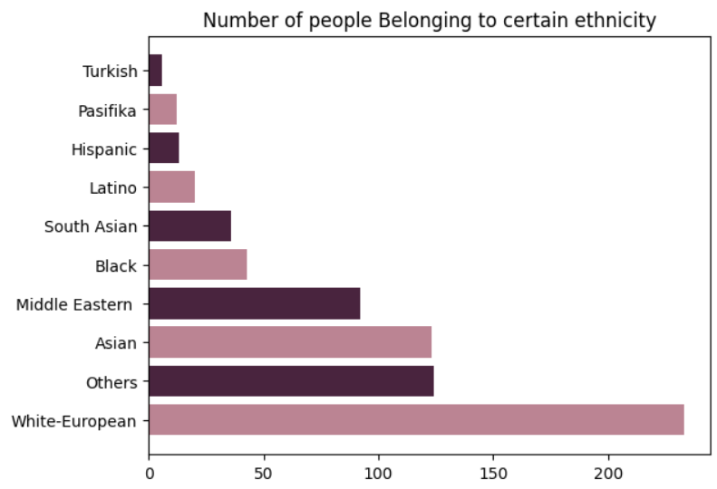
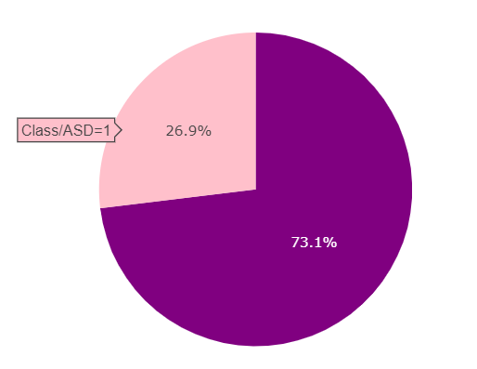
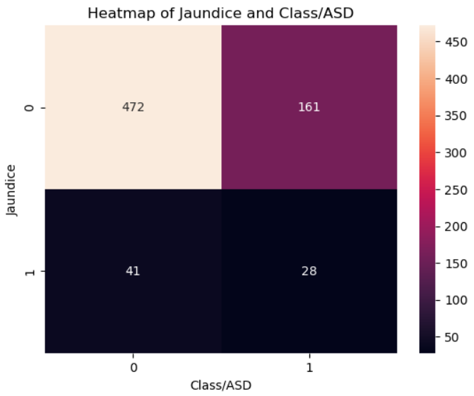
AUTISM SPECTRUM DISORDER

Slide 6
MDVP:Jitter(%), MDVP:Jitter(Abs), MDVP:RAP, MDVP:PPQ, Jitter:DDP
Several measures of variation in fundamental frequency
Parkinsons Dataset information
04
MDVP:Shimmer, MDVP:Shimmer(dB), Shimmer:APQ3, Shimmer:APQ5, MDVP:APQ, Shimmer:DDA
Several measures of variation in amplitude
05
NHR, HNR
Two measures of ratio of noise to tonal components in the voice
06
MDVP : Fo(Hz) :
Average vocal fundamental frequency
RPDE, D2
Two nonlinear dynamical complexity measures
01
07
MDVP : Fhi(Hz) :
Maximum vocal fundamental frequency
DFA
Signal fractal scaling exponent
02
08
spread1, spread2, PPE
Three nonlinear measures of fundamental frequency variation
MDVP : Flo(Hz) :
Minimum vocal fundamental frequency
03
09

Slide 7

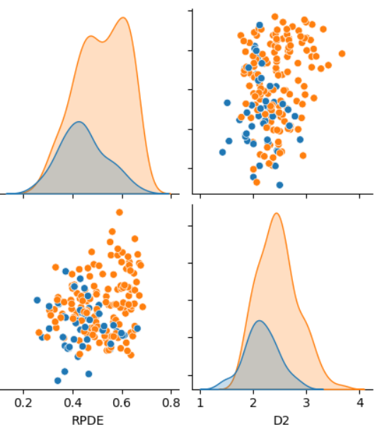
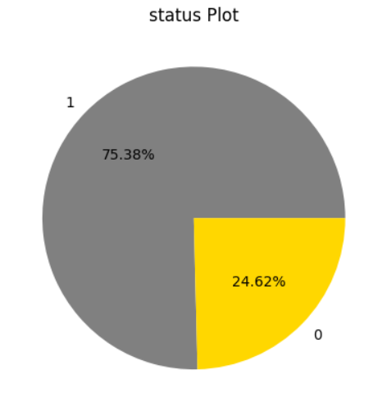
Parkinsons Disease

Slide 8
Lung Cancer Dataset Information
Gender - Male or Female
Peer Pressure - No (1) , Yes (2)
Alcohol Consumption -
NO (1) , YES (2)
Age in Years
Chronic Disease - No (1) , Yes (2)
Coughing - No (1) , Yes (2)
Smoking - No (1) , Yes (2)
Fatigue - No (1) , Yes (2)
Shortness of Breath -
No (1) , Yes (2)
Yellow Fingers -
No (1) , Yes (2)
Allergy - No (1) , Yes (2)
Swallowing Difficulty -
No(1) , Yes (2)
Anxiety - No (1) , Yes (2)
Wheezing - No(1) , Yes (2)
Chest Pain - No (1) , Yes (2)

Slide 9
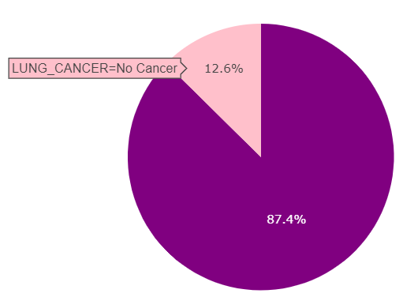
Lung Cancer
The Pie Chart Shows The Distrbution of people having lung cancer (87.4%) and people who dont have lung cancer (12.6%)

Slide 10
Strokes Dataset Information
Gender - Male, Female, Others
Hypertension - Whether the Person has Hypertension or not
Ever Married - Has the person ever been married or not
Glucose - The glucose level of the person
Smoking Status - Has the person Ever Smoked or not
Age - Age in Years
Heart Disease - Whether the Person has Heart Disease or not
Residence Type - In wht are does the person reside in
BMI - The Body Mass Index of the person
Work Type - Work type of the patient

Slide 11
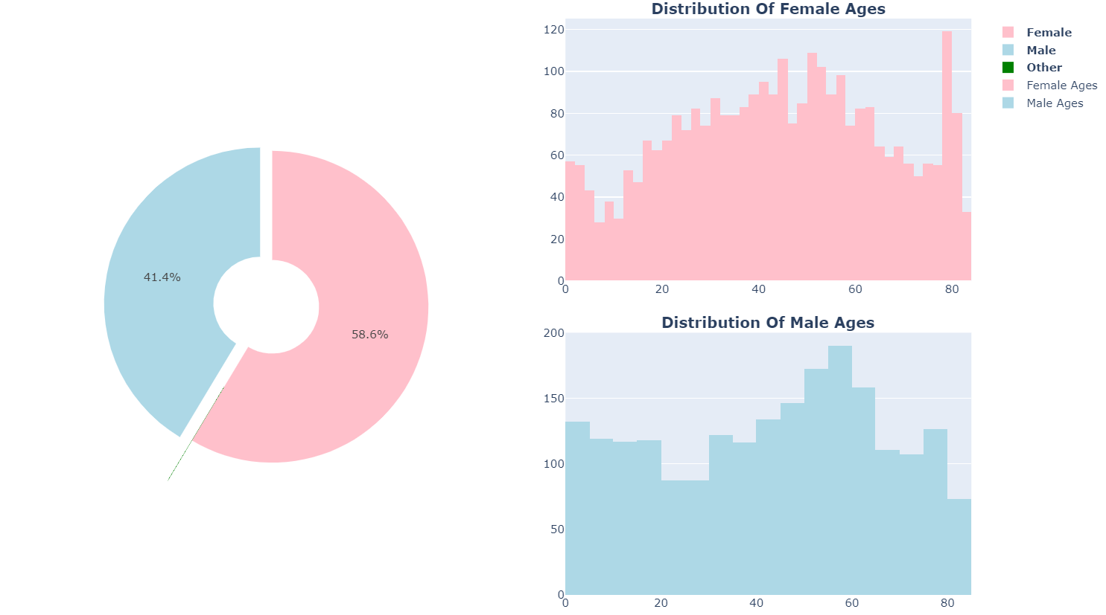
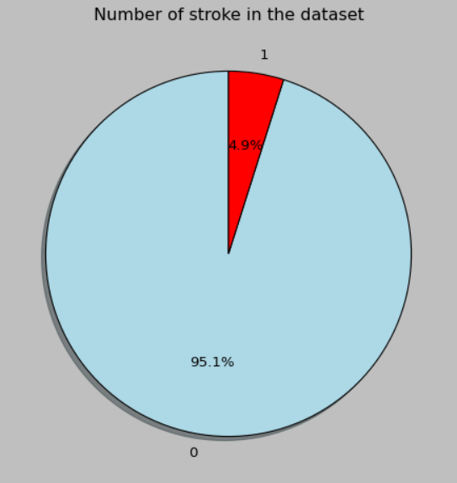
Strokes Prediction

Slide 12
Glucose Level : Plasma glucose concentration a 2 hours in an oral glucose tolerance test
Blood Pressure Value : Mention your Blood Pressure Value
Skin Thickness value : Diastolic blood pressure (mm Hg)
Diabetes Pedigree Function value : Diabetes pedigree function
Insulin sort : 2-Hour serum insulin (mu U/ml)
BMI : Body mass index (weight in kg/(height in m)^2)
Age : Age in Years
Diabetes Dataset Information
Number of Pregnancies : Number of times pregnant

Slide 13
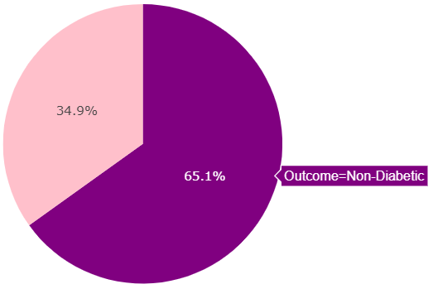
Diabetes Prediction
The Pie Chart Shows The Distrbution of Diabetic (34.9%) vs Non-Diabetic Persons (65.1%)

Slide 14
Covid-19 Dataset Information
Rate Of Dry Cough : Enter the rate between (0-20) | Rate Of Fever : Enter the rate of you fever between (0-20)
Rate Of Sore Throat : Enter the rate between (0-20) | Rate Of Breathing Problem : Enter the rate of your problem in breathing (0-20)

Slide 15
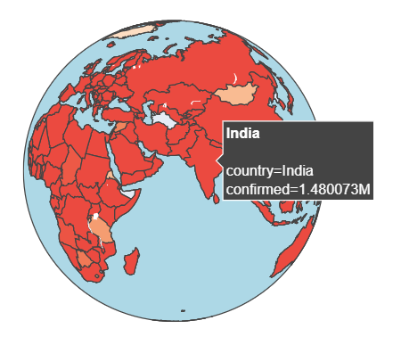
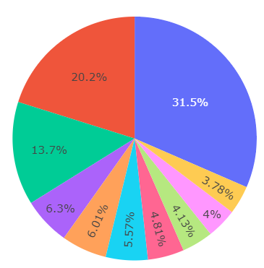
Covid-19 Prediction
PIE CHART SHOWING THE DISTRIBUTION OF TOP 10 COUNTIRES WITH MOST CONFIRMED CASES
US has most number of confirmed cases with 31.5% followed by india with 20.2% ten brazil with 13.7% then france with 6.3% then UK with 6.01% then russia with 5.57% then turkey with 4.81% then germany with 4.13% then italy with 4% then spain with 3.78%

Slide 16
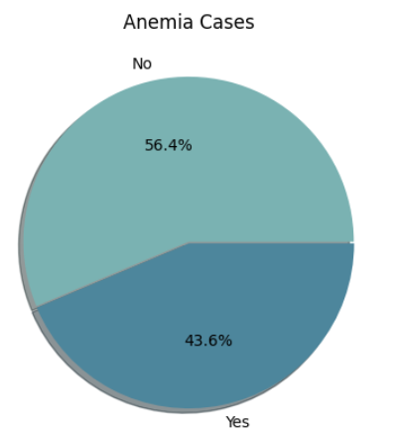
Anemia Dataset Information
Gender : Tells if the person is a boy or a girl.
Haemoglobin : Shows how much oxygen-carrying stuff is in their blood.
MCH (Mean Corpuscular Hemoglobin) : Checks how much of that stuff is inside each red blood cell.
MCHC (Mean Corpuscular Hemoglobin Concentration) : Checks if the stuff in the red blood cells is dense enough.
MCV (Mean Corpuscular Volume) : Checks the size of the red blood cells.
Result : Tells if everything's okay or if there might be a problem with the blood.

Slide 17
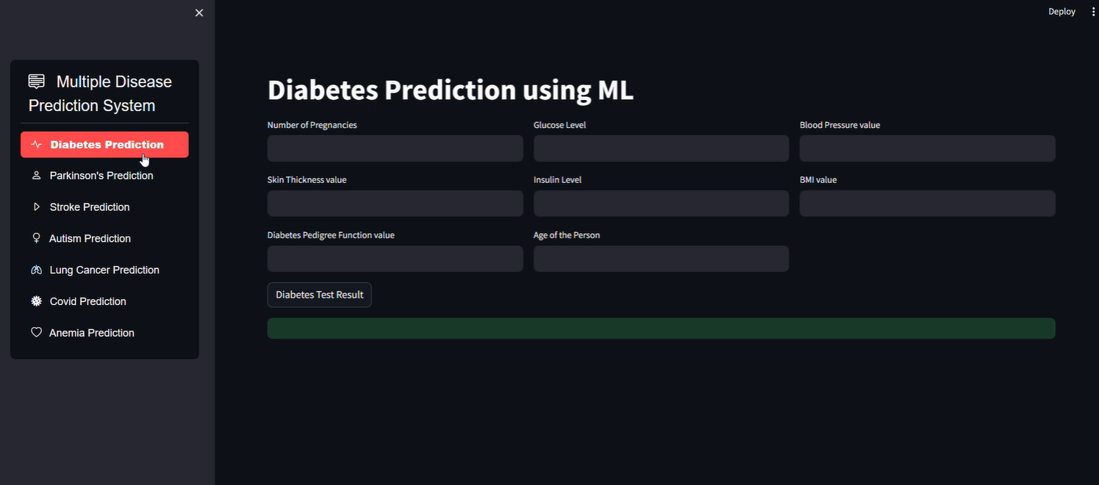

Results

Slide 18
APSC TEAM
Thank you!

